Slide 1


Pointers
Presented By -
Punam Kumbhar

Slide 2
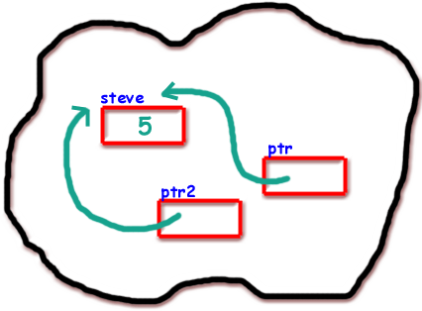
Agenda
Why pointer ?
What is a pointer ?
Declaration, assignment, dereferncing a pointer
Pointer operators
Operations on pointers
Difference between char & int ptr
Pointer to array

Slide 3
Why pointers ?....
Allocating a memory dynamically
  - saves memory
To return more than one value from a function.
File operations & we can different types of data structures like linked list,tree,graph can be implemented using pointers.

Slide 4
Using pointers we can reduce the no. Of lines
Void strcpy(char *s, char *p)
{
Int i = 0;
while(s[ i ] = t[ i ]) != '\0')
i++;
}
Void strcpy(char *s, char *p)
{
while(*s++ = *t++) != '\0');
}

Slide 5
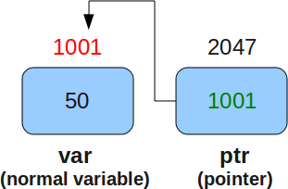
What is a Pointer?
  Pointer is a variable which holds the address of another variable and having dereferncing properties.

Slide 6

Declaration Of a Pointer
Like all other variable pointer variable is also to be declared before being used.
The general syntax of declaration is :
data_type * p_name;
Some examples are
int *iptr;
char *cptr;
double *dptr;
Pointers are variables so compliler will reserve space for them and they also have some address.Pointers irrespective of their data type generally occupies same space.

Slide 7
Pointer operators
Mainly two operators we have to consider while using pointers. They are
1. Address operator (&)
2. Dereferncing operator (*)
Address operator(&)
The address operator gives the address of variable when placed before it. The format specifier “ %p “ is used to print the address.These address may be different each time when you run your program, it depends on which part of memory is allocated for that variable.
The address operator cannot be used on constant values, expressions and register variables.
Ex :-
&1;
&reg_var;
&(a+b);

Slide 8
Contd....
Dereferencing operator (*) :-
It is used for indirectly accessing of a variable by using pointers.
Example:-
char *p1 ;
1200 2622 2623 2624 2625 2626
    p1
int *p2;
  2106 2120 2121 2122 2123 2124
  p2
2622
's' | 'r' | 'i'
2120
ff | 32 | 21 | 21

Slide 9
Difference between char & integer pointer
- size of integer and char pointer gives 4 bytes
char *ptr;
int *ptr;

Slide 10
2000 1000
Assigning to a pointer
Generally global and local static pointers automatically initialized to NULL, when we declare a pointer variable it contains garbage value i.e it may point to any where.So we have to assign an address before using it in the program.
int *iptr;
int a = 20;
iptr = &a;
iptr a
1000
20

Slide 11
Dereferencing a pointer variable
We can also access a variable indirectly using pointers. For this we will use indirection operator (*).
By placing indirection operator before a pointer variable we can access the variable.
Example:-
int main(void)
{
int a = 10;
int *iptr = &a;
*iptr = 20;
printf(“%d %d\n”,a,*iptr);
return 0;
}

Slide 12

Assigning pointer to pointer
It is also possible to assign the value of one pointer variable to other, provided their
base types is same.
int *pr1;
int *pr2;
int num = 123;
pr2 = &num;
pr1 = &pr2;

Slide 13
Pointer Arithmetic
There are only some arithmetic operations are valid on pointers.They are
(i) Addition of an integer from a pointer and increment operation.
(ii)Subtraction of an integer from a pointer and decrement operation.
(iii)subtraction of a pointer from another pointer.
Example:-
int i = 0;
int *ptr = &i;
ptr+1;
ptr++;
ptr--;
ptr-1;

Slide 14
Precendence of dereferencing and Increment/decreement operator
The precedence of '*' and increment/decrement operators is same and associativity is from right to left. Mainly we have four types of pointers expressions with these operators. They are
base_type * ptr_name;
1. *ptr++
2. *++ptr
3. ++*ptr
4. (*ptr)++
Example:-
int x = 21;
int *ptr = &x; ptr x
3000 2000
1. x = *ptr++;
2000
21

Slide 15
Contd.....
2. x = ++*ptr;
3. x = (*ptr)++;
4. x = *++ptr

Slide 16
Pointer vs Constant
There are mainly three types of there in this.They are
1.base_type * const ptr_name
2.const base_type * ptr_name
3.const base_type * const ptr_name
Example:-
int *const p;
const int *p;
const int * const p;

Slide 17
Pointer and Arrays
Is there any difference between array & pointer ?
Pointer to 1-D array :-
Let's take a pointer variable ptr and initialize with address of starting element of an array arr.
Ex:-
int *ptr;
ptr = arr;
Illegal operations on array name:-
arr = &num;
arr++;
arr = arr – 1;

Slide 18
How to access using pointers?
On applying pointer arithmetic and dereferencing we can see that the expression ptr+i denotes the address of
i th element of an array and the expression *(ptr+i) denotes the value of i th element of an array.
Difference between name of an array and a pointer variable
Array:-
arr = &num;
arr++;
arr = arr-1;
Pointer:-
ptr = &num;
ptr++;
ptr = ptr-1;

Slide 19
Array of Pointers
We can declare an array that contains pointers as its elements.Every element of this array that can hold address of any variable of appropriate type.
The syntax for declaring array of pointers is
datatype * arr_name [size];
Example
int main(void)
{
  int *arr[2];
  int a =5;
  int b= 3;
  arr[0] = &a;
  arr[1] = &b;
  printf(“%d %d\n”,a,*arr[0]);
  printf(“%d %d\n”,b,*arr[1]);
  return 0;
  }

Slide 22

Any Questions

